Slide 1
7. Video coding (Part 3)
⎯MPEG-2
Yi-Shin Tung
National Taiwan University

Slide 2
Applications and requirements
Applications
  Initial target is to code interlaced CCIR 601 video at 4~9 Mbits/s.
  A generic standard instead of a standard for some specific application.
Requirements
  Coding of CCIR-601 4:2:0 interlaced video at 4~9 Mbit/s with good quality.
  Variety of picture resolutions and formats, including 4:2:2 and 4:4:4 chroma formats
  Special modes with low coding/decoding delay
  Compatibility with MPEG-1 video coding
  Scalability
  Resilience to errors typically in storage or transport

Slide 3
ISO/IEC 13818 (ITU-T H.262)
Information technology – Generic coding of moving pictures and associated audio information
  Part 1: Systems
  Part 2: Video
  Part 3: Audio
  Part 4: Conformance testing
  Part 5: Software Simulation
  Part 6: Extensions for DSM-CC
  Part 7: Advanced Audio Coding (AAC)
  Part 8: 10-bit color depth (discontinued)
  Part 9: Extension for real time interface for systems decoders
  Part 10: Conformance extensions for Digital Storage Media Command and Control (DSM-CC)
  Part 11: IPMP on MPEG-2 Systems

Slide 4
Reference decoding model for MPEG-2
Source
Video
Demultiplexer
Delivery
Audio
Interaction

Slide 5
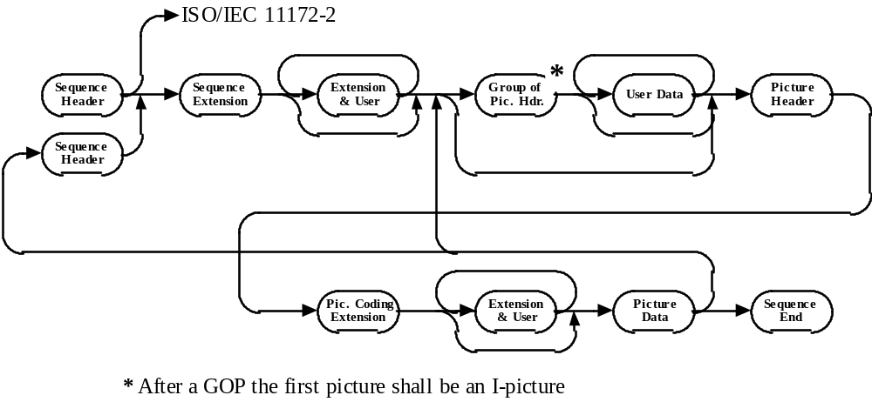
High-level Bitstream Organisation

Slide 6
New Features of MPEG-2
Range extension for width, height, bitrate and so on.
Higher dc precision.
Separate quantization tables for luma and chroma.
Interlace coding tools
  Picture structure
  Motion compensation
  DCT type
Scalable Extension --base and enhanced layers
Error concealment
Profiles and Levels --example: M.P.&M.L.
  Profile --a defined sub-set of the entire bitstream syntax
  Level --a defined set of constraints imposed on parameters in the bitstream

Slide 7
Interlace support: frame/field pictures
Progressive sequence, progressive frame
Two picture structures are allowed in progressive frame.
  Field picture consists of individual fields. Each field is coded separately. Two fields form a frame.
  Frame picture combines two fields interleaved.
Decoded
top field
Decoded
bottom field

Slide 8
Interlace support: prediction mode
3 prediction modes are allowed in two different picture structures, respectively.
Prediction modes in frame picture
  Frame prediction
  Field prediction for frame
  Dual-prime prediction for frame
Prediction modes in field picture
  Field prediction for field
  16x8 motion compensation
  Dual-prime prediction for field
All types of predictions
  Frame prediction
  Field prediction
  16x8 motion compensation
  Dual-prime

Slide 9
Frame prediction in frame picture
This mode is the same as that used in MPEG-1 video
Work well for slow and moderate motion as well as panning over a detailed background.
P-frame
Reference Frame
target
Possible
Intervening
B-pictures
(not yet decoded)
B-frame
Reference Frame
target
Reference Frame
Possible
Intervening
B-pictures
(already decoded)
Possible
Intervening
B-pictures
(not yet decoded)

Slide 10
Field prediction in field picture
Conceptually similar to frame prediction.
It is possible to predict from the same frame with opposite parity.
Simplicity, and work well for slow to moderate motion.
Prediction for first field
Top
Reference Field
target
Prediction for second field
Bottom
Reference Field
Top
Reference Field
Possible
Intervening
B-pictures
(not yet decoded)
Bottom
Reference Field
target
Possible
Intervening
B-pictures
(not yet decoded)

Slide 11
Field prediction in field picture
Both fields of B frame are coded using previous and next I and P frames.
Top
Reference Field
Top
Reference Field
target
Bottom
Reference Field
Bottom
Reference Field
Possible
Intervening
B-pictures
(already decoded)
Possible
Intervening
B-pictures
(not yet decoded)
Prediction of B filed pictures

Slide 12
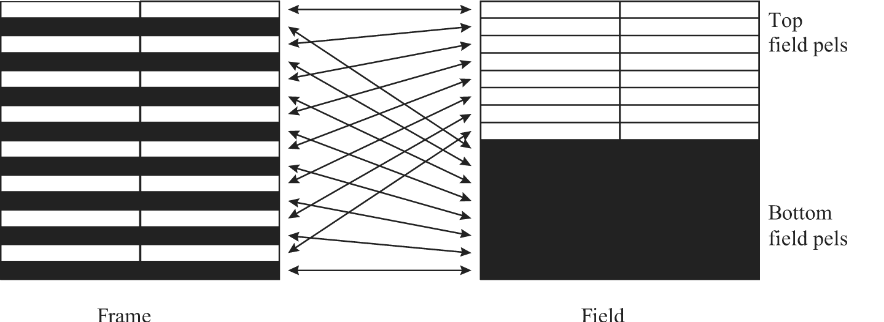
Field prediction in frame picture
Target MBs are first split into top-field pels and bottom-field pels.
16x8 prediction cannot come from the same frame as its target MB.
Useful mainly for rapid motion.

Slide 13
16x8 MC in field picture
Split the field MB into an upper half and lower half, and performs a separate field prediction for each.
2/4 MVs for P/B picture
Effective in field pictures that contain a lot of irregular motion.
Possible
Intervening
B-pictures
(already decoded)
Possible
Intervening
B-pictures
(not yet decoded)
16
8
8

Slide 14
Low delay mode: dual prime
Two preliminary predictions are computed and averaged to form the final prediction.
Restrictions: cannot be used if
  The previously coded picture was a B-picture
  The first I-field picture of a frame.
A delta motion vector (dmv, ±1/2 pel) is allowed.
Performance can rival that of B-picture and has lower encoding delay advantage.
Memory bandwidth requirements are usually higher.
  One MV together with a small differential MV. Average top field and bottom field to form final prediction
  Used in P-pictures where there are no B-pictures between the predicted and reference fields or frames.

Slide 15
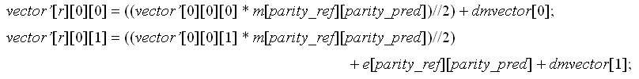
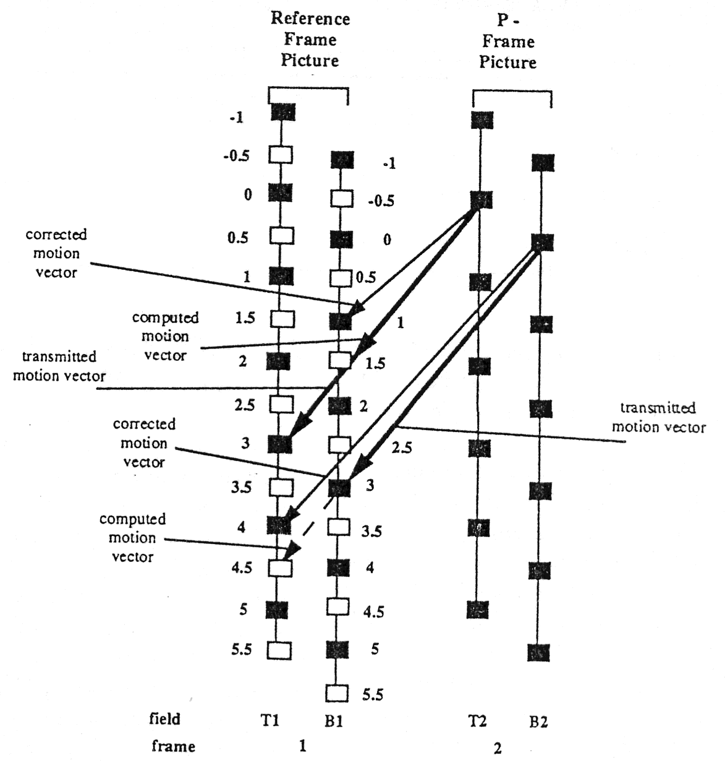
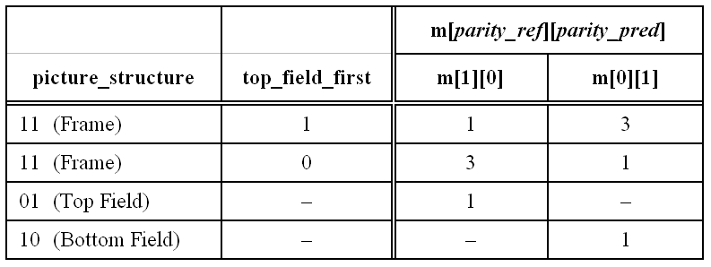
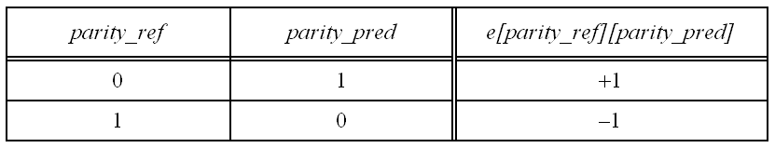
Low delay mode: dual prime

Slide 16
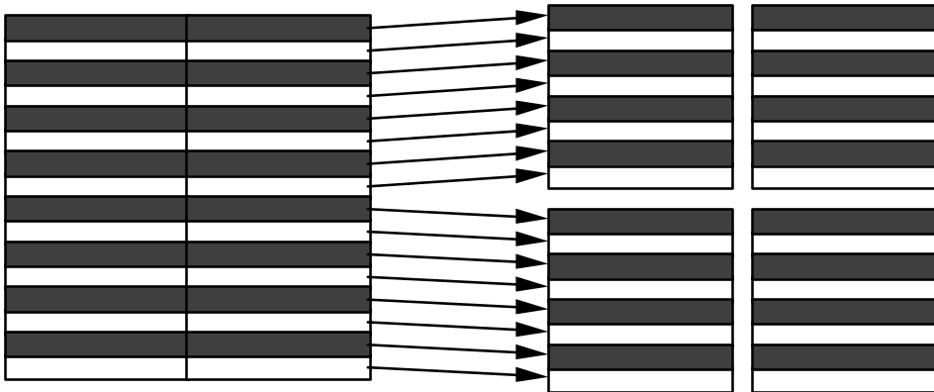
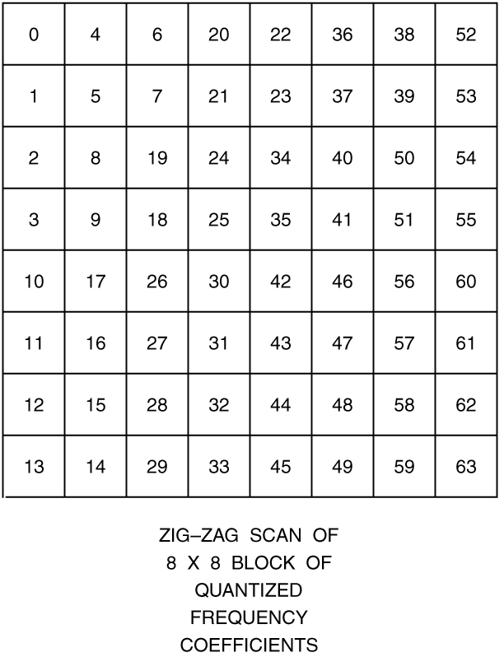
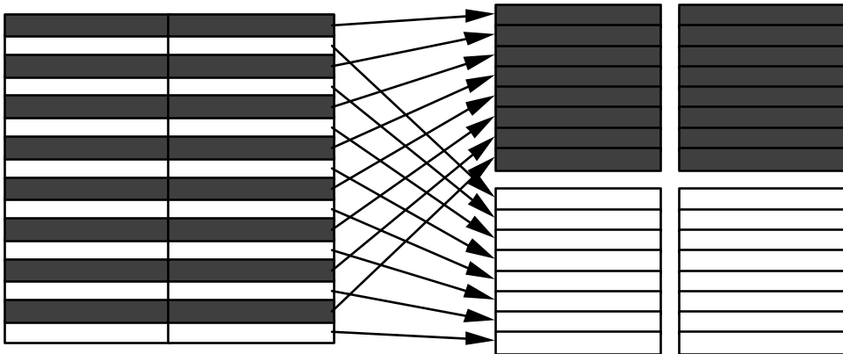
Frame/Field DCT
Alternate scan is supported in picture basis
Permutation for frame DCT
Permutation for field DCT

Slide 17
Relationships
Correlation between picture types, predictions, and DCT types.
Frame Picture
Frame
Prediction
Frame DCT
Field Picture
Field
Prediction
Field DCT
16x8
Prediction
Dual prime

Slide 18
Non-scalable Video Coding
Sys Mux
Sys Demux
Inter frame/field
DCT Encoder
Variable
Length
Encoder
Variable
Length
Decoder
Inter frame/field
DCT Decoder
Video in
Video out
Frame/field Motion
Estimator and
Compensator
Frame/field Motion
Compensator
mv
mv

Slide 19
Scalable Video Coding
Four types of scalability
  SNR Scalability
    Provide graceful degradation of video quality
    Base layer with coarser quantization scale and enhancement layer with finer quantization scale
  Spatial Scalability
    Support displays with different spatial resolutions at the receiver end, for example, SDTV/HDTV systems
    Base layer with lower spatial resolution while enhancement layer with higher spatial resolution

Slide 20
Scalable Video Coding (cont.)
  Temporal Scalability
    Can support stereoscopic display capacity at the receiver end
    Base layer with lower temporal resolution while enhanced layer with higher temporal resolution
  Data Partitioning
    Split data into two streams to increase error resilience capability applicable to channels with different error properties.
    Break the 64 coefficients into two bitstreams, one for headers and motion vectors and low-frequency coefficients, and the other for high-frequency coefficients.
Hybrid scalability
  At most 3 layer support (2 types of scalability)

Slide 21
MPEG-2
Enhancement
Video Encoder
MPEG-2
Enhancement
Video Decoder
Sys Mux
Sys Demux
Pre-
Processor
Post-
Processor
Enhanced
Quality
Video in
Mid-
Processor
Mid-
Processor
MPEG-1/2
Nonscalable
Video Encoder
MPEG-1/2
Nonscalable
Video Decoder
Base
Quality

Slide 22
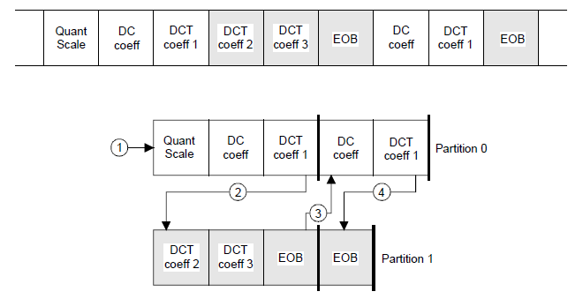
Error concealment
Data partitioning
SNR scalability
Concealment motion vectors by intra MB
  Frame prediction for frame picture
  Field prediction for field picture
Effective at bit error rates up to 10 ⁻⁴ and usable up to 10⁻³.

Slide 23
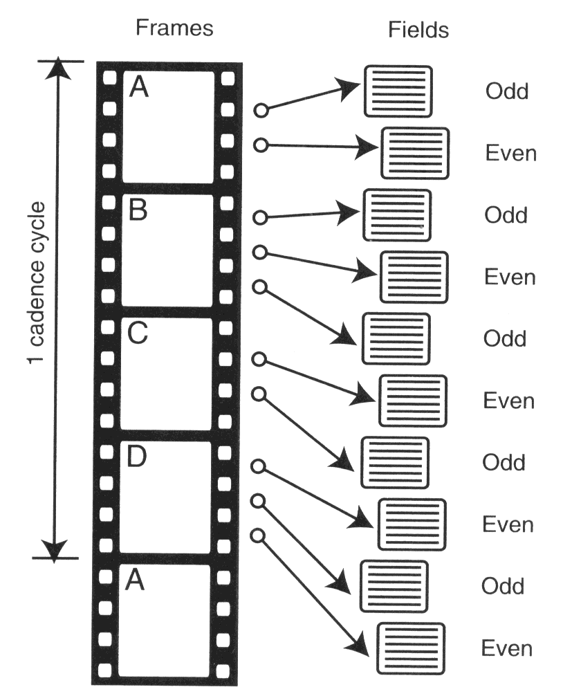
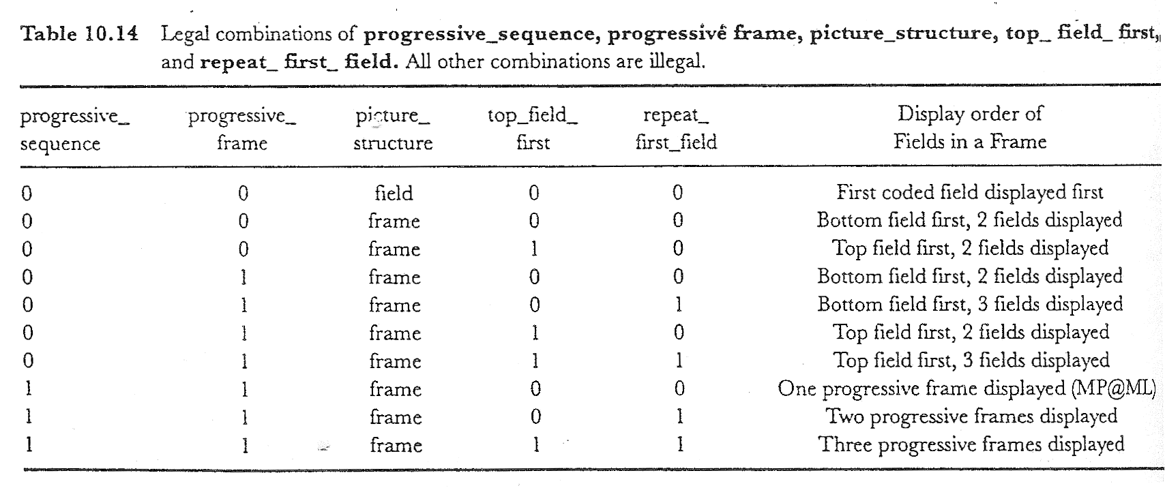
3:2 pull down
24 frame/s progressive film source by interlaced display.
1:1
3:2 pulldown
for interlace
3:2 pulldown
for progressive

Slide 24
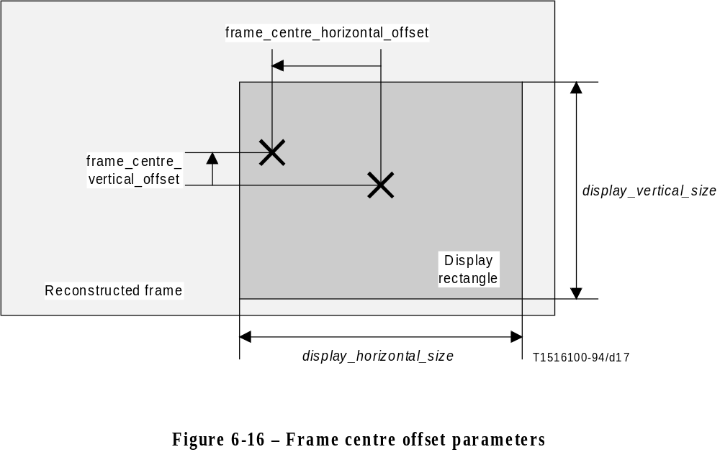
Aspect ratio conversion (ARC)
Pan and scan support (cropping)
  display_horizontal_size, display_vertical_size
  Frame_centre_horizontal_offset, frame_centre_vertical_offset (up to 3 pairs/picture)
Aspect ratio conversion, ARC (padding)
  Blank areas on top/bottom or left/right
4:3 to 16:9
16:9 to 4:3

Slide 25
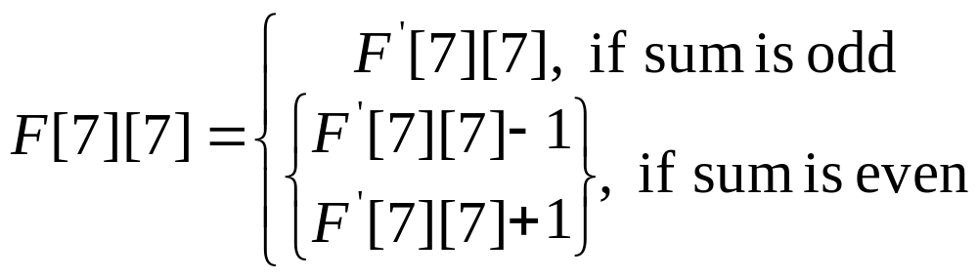
Mismatch control
IDCT inherently requires floating ops, but is usually implemented by fast integer ops.
Different IDCT implementations may result in some mismatches, which is constrained under IEEE 1180-1990.
To prevent a large quantity of mismatches due to rounding of 0.5, mismatch control is used.

Slide 26
MPEG-2 video profiles
Simple
Main
SNR
scalable
Spatial
scalable
High
Multiview
4:2:2
Profile
Level
High level
X
X
High-1440 level
X
X
X
Main level
X
X
X
X
X
X
Low level
X
X
Note: All MPEG-2 compliant decoders should be
capable to decode MPEG-1 CPS bitstream.

Slide 27
Profile hierarchy and new profiles
MPEG-1 CPS
Simple Profile
Main Profile
4:2:2 format
SNR Profile
Spatial Profile
interlace
High Profile
B-frame
422 Profile
SNR scalability
Temporal scalability
Multiview Profile
Spatial scalability
4:2:2 format

Slide 28
MPEG-2: Systems
Basic data structure
  Packetized elementary stream (PES) packets
Two types of streams
  Program stream
    long and variable-length packets
    suitable for software-based processing and error-free environments
    interleaving PES packets from different encoders
  Transport stream
    fixed-length packets of size 188B
    the robustness suitable for error-prone channels
    the ability to include multiple programs in a single stream
    chopping up the data in PES packets

Slide 29
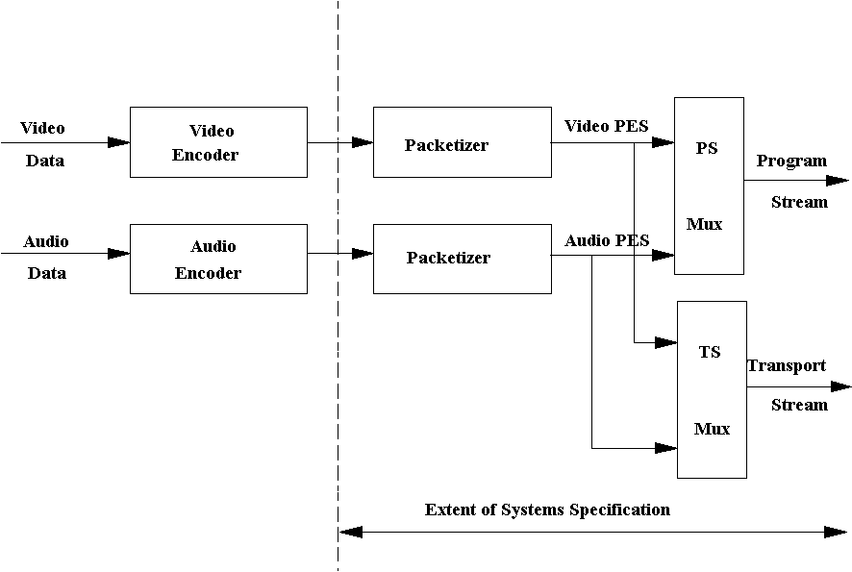
Model for MPEG-2 Systems

Slide 30
Functionalities of MPEG-2 systems
Adaptation of the bitstream to the physical layer
Multi-program support
  the ability for a bitstream to carry more than one program
Stream identification
Encryption support
  two special streams called ECM and EMM that carry information used to decrypt information carried by the MPEG-2 Transport Stream
  The encryption system itself is not specified by MPEG
Copyright identification
  support for the management of audio-visual works copyrighting by means of a copyright descriptor

Slide 31
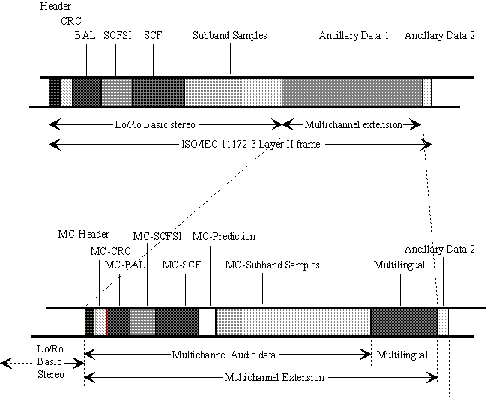
Backward Compatible Audio

Slide 32
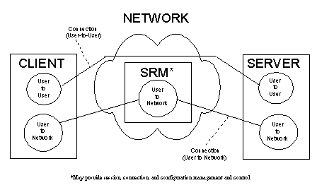
Digital Storage Media Command and Control (DSM-CC)
the specification of a set of protocols which provide the control functions and operations specific to managing MPEG bitstreams
may be used to support applications in both stand-alone and heterogeneous network environments

Slide 33
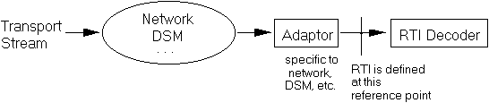
Real Time Interface (RTI)
a specification for a real-time interface to Transport Stream decoders which may be utilised for adaptation to all appropriate networks carrying Transport Streams
to achieve equipment-level interoperability in consumer electronic, computer, and other domains

Slide 34
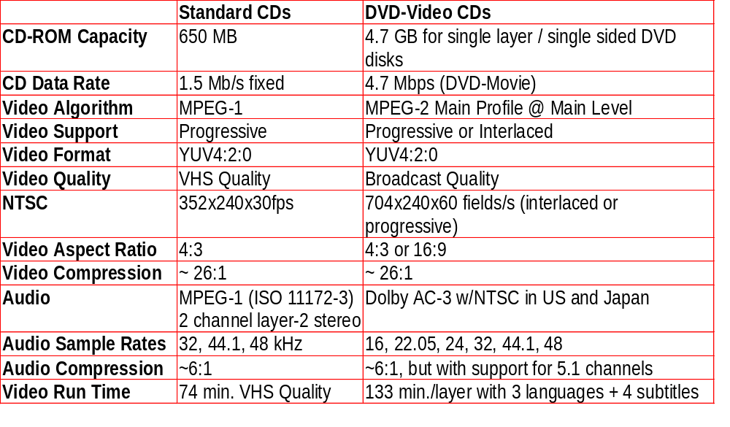
VCD v.s. DVD

Slide 35
MPEG Playback
VCD
  Hardware: 486
  Software: P-133
DVD
  Hardware: P-133 and above
  Software with hardware accelerator: P-200 MMX
  Pure software: PII-300

Slide 36
Homework
5. Design/explore/describe a fast mode decision method to efficiently decide prediction mode for interlace contents in MPEG-2 video. Explain why it is effective, and how much computation can it reduce?

